Slide 1







REGISTERED OFFICE: VIA NOVARA 166, 28069 TRECATE (NO) – PHONE: +39.0321/784111 – FAX: +39.0321/784150
ADMIN. HEADQUARTERS: VIA G. FERRARIS 13, 43036 FIDENZA (PR) – PHONE: +39.0524/530259 – FAX: +39.0524/530142
Certified company ISO 9001:2015 – ISO 14001:2015 – ISO 45001:2015
Certificates N° ER-0274/2006 – GA-2012/0248 – SST-0064/2019
info@ciiguatellispa.it
www.ciiguatellispa.it

Slide 2






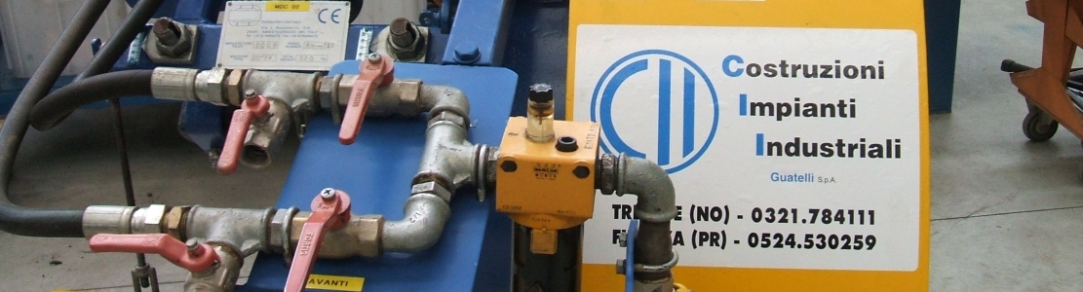
COSTRUZIONI IMPIANTI INDUSTRIALI GUATELLI S.P.A.
The company Costruzioni Impianti Industriali Guatelli S.p.A. carries out maintenance and construction of pipelines (gas pipelines, oil pipelines and aqueducts) at the main Italian customers in the industry, oil depots maintenance and emergency service 24 hours a day to restore the the functionality of the systems.
The last specialistized activities included in the package of customer service are:
  resolution of interferences with other services (railways, roads and urbanization), from the feasibility study to the delivery of the work including administrative practices of servitude and testing
  Horizontal Directional Drilling, to change the position of a pipelines minimizing the environmental impact
  gas evacuation, to prevent gas leakage from a pipeline into the atmosphere

Slide 3
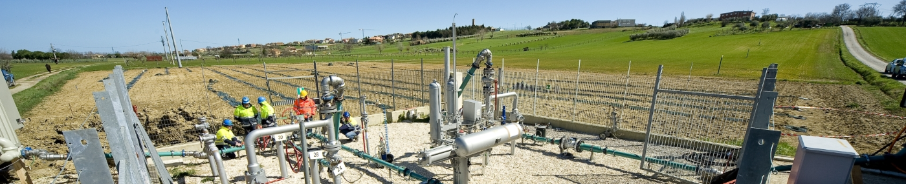
QUALIFICATION
C.I.I. Guatelli S.p.A. is qualified for the execution of public works (construction and design) from Bentley SOA, certification n° 19922/35/00 of October 19, 2016, in the categories:
OG1 (civil and industrial buildings) – class III
OG3 (roads, highways, bridges, viaducts, ...) – class III
OG6 (acqueducts, gas pipelines, oil pipelines, ...) – class VII
At work since
1963

Slide 4
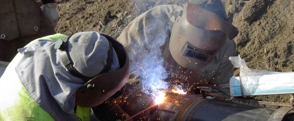
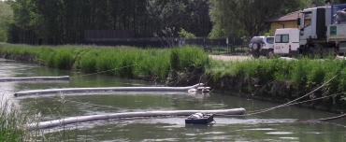
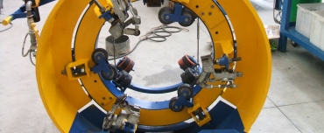
OUR AREAS
PIPELINES
ENVIRONMENT
SERVICES
Construction, ordinary and extraordinary maintenance of pipelines
Construction, ordinary and extraordinary maintenance of gas pipelines
Construction, ordinary and extraordinary maintenance of aqueducts
Emergency service in case of pollutants dispersion and relative availability 24 hours a day, 365 days a year
Production and trade of specific anti-pollution and reclamation products
Plants and pollution response
Excavation, backfilling, drainage and reclamation with environmental restoration
Damming of rivers, lakes, open water and cleaning treatment
Consolidation of washouts and restores
Service of line inspection of pipelines
Full-time emergency service for the limitation of spills of unexpected petroleum products

Slide 5
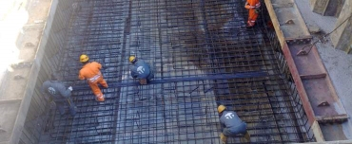
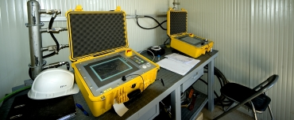
OUR AREAS
INSTALLATIONS
GAS EVACUATION
Construction, installation, ordinary and extraordinary maintenance of fuel depots
Construction, installation, ordinary and extraordinary maintenance of firefighting equipments
Construction, installation, ordinary and extraordinary maintenance of iron carpentry
Construction, installation, ordinary and extraordinary maintenance of tanks
Mechanical demolitions
The recompression uses N° 2 compressors that allow the suction of gas CH4 from 75 bar to 7 bar and from 30 bar to 0 bar and next compression the pressures required by the Client. The recompression can use the single compressor or in couple connected in series.
Gas pipeline evacuation

Slide 6
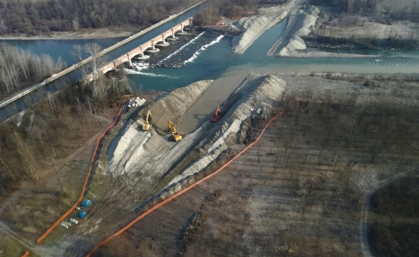
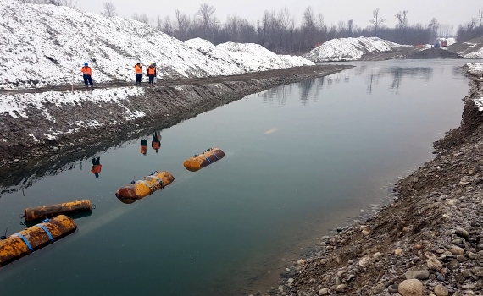
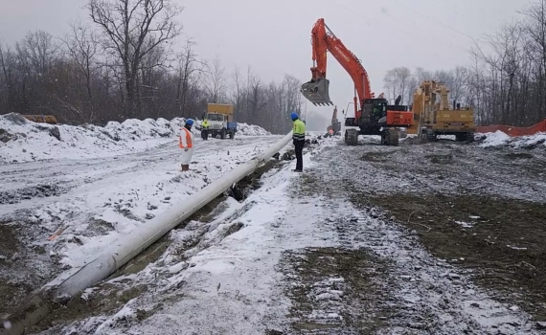
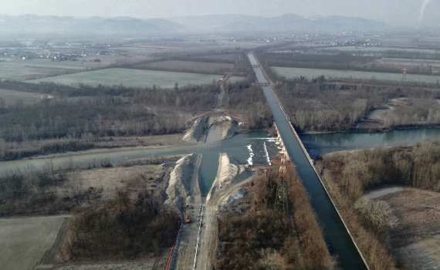
PIPELINE TRECATE-CHIVASSO DN 10" – DORA BALTEA RIVER CROSSING
CLIENT
WHERE
WHEN
DESCRIPTION
Esso Italiana S.r.l.
Saluggia (VC) - Italy
2017-2018
Execution of an open-air crossing of the Dora Baltea. Launch of the pipeline.

Slide 7
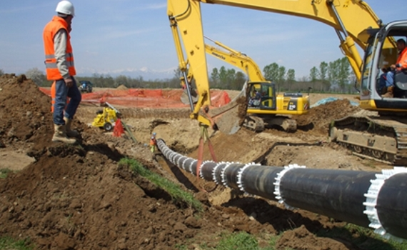
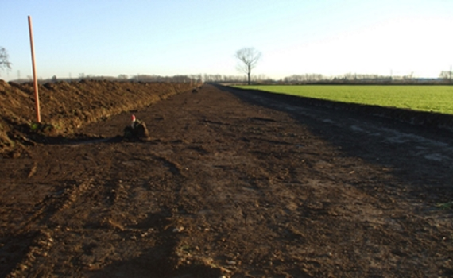
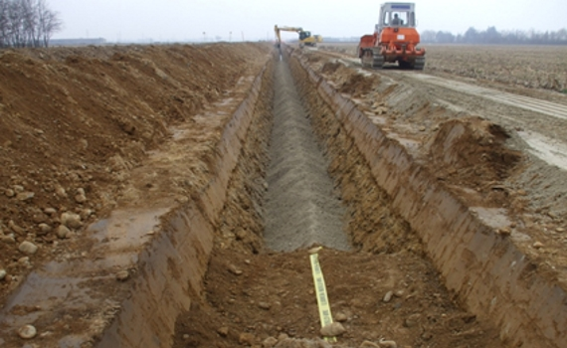
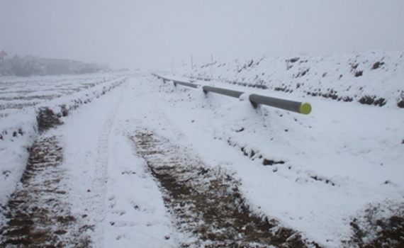
PIPELINE CONSTRUCTION
CLIENT
WHERE
WHEN
DESCRIPTION
SNAM Rete Gas S.p.A.
Caltignaga, Vaprio, Suno (NO) - Italy
2009-2010
The site has involved the construction of the pipeline variant Caltignaga-Borgomanero for a section of 10 Km in the municipalities of Caltignaga, Vaprio d'Agogna and Suno.

Slide 8
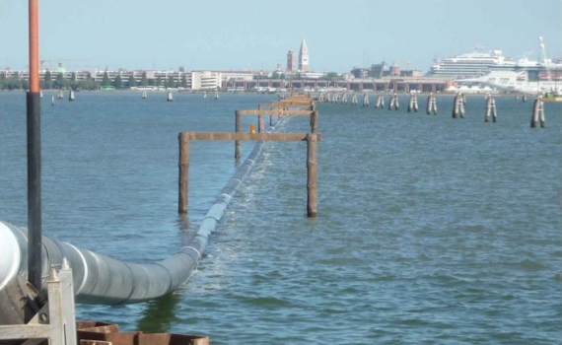
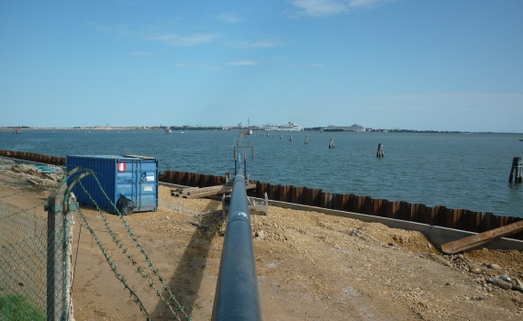
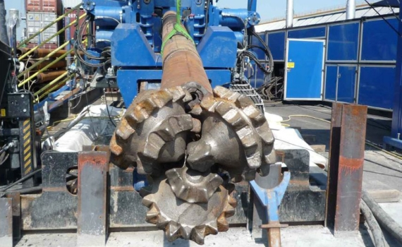
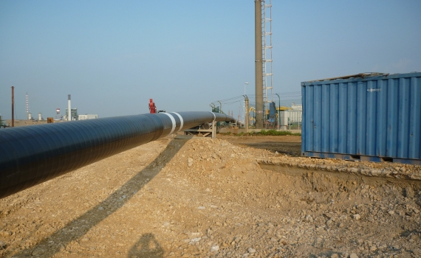
CROSSING THROUGH HORIZONTAL DIRECTIONAL DRILLING (D.H.H.)
CLIENT
WHERE
WHEN
DESCRIPTION
I.E.S. S.p.A.
Venezia (VE) - Italy
2009
Crossing of the evolution basin n ° 3 through the use of Horizontal Directional Drilling - Pipeline Island Petroli - Coastal depot DN 500 (20") I.E.S. S.p.A.

Slide 9
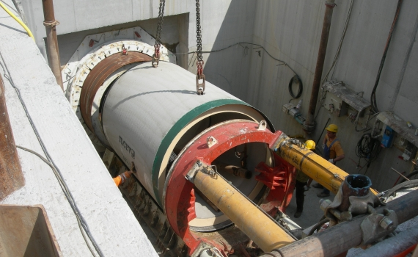
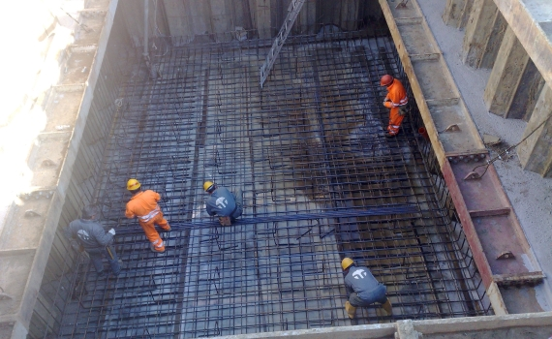
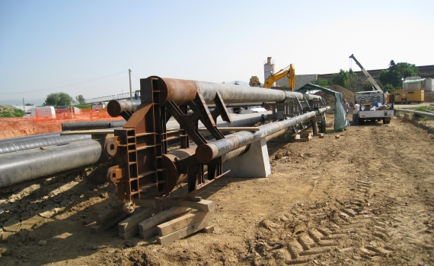
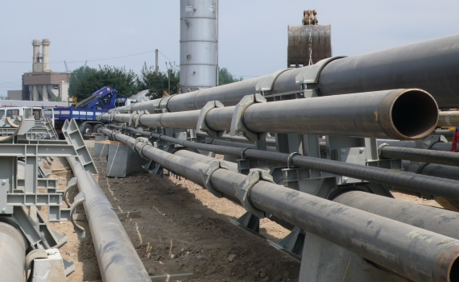
CROSSING THROUGH MICROTUNNEL
CLIENT
WHERE
WHEN
DESCRIPTION
SNAM Rete Gas S.p.A. – Eni S.p.A.
San Donnino (FI) - Italy
2008-2009
The site involved the crossing of the river Arno, through a tube bundle in a curved microtunnel to pass under both the river and the railway line Florence-Pisa for a length of 483 m. The tube bundle consisted of three oil pipelines DN 200 (8") and two gas pipelines ,DN 400 (16") and DN 500 (20"), with theirs trays of protection for the traits at the underpass of the railway line.

Slide 10
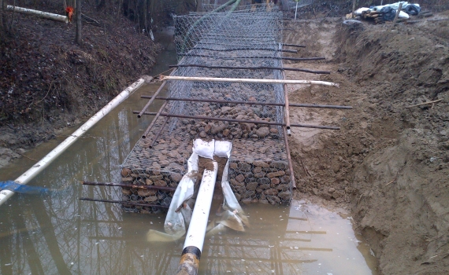
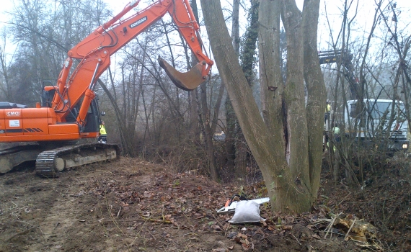
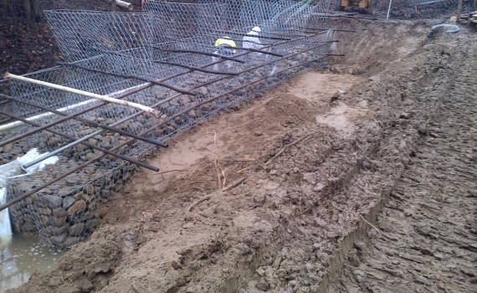
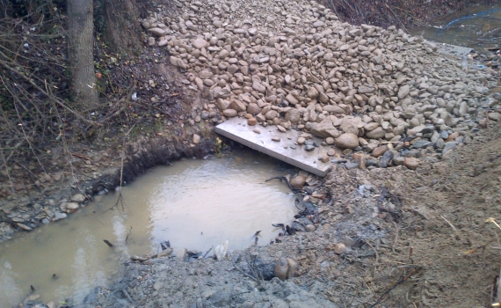
RECONSTRUCTION OF RIVERBED
CLIENT
WHERE
WHEN
DESCRIPTION
S.A.R.P.O.M. S.r.l.
Acqui Terme (AL) - Italy
2013
Reconstruction of the Rio Medrio’s riverbed to secure the oil pipeline DN 8".

Slide 11
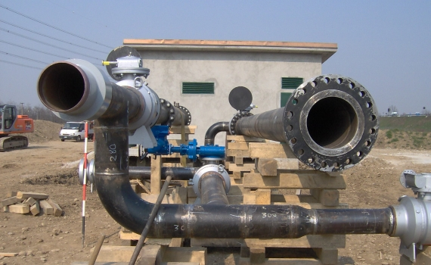
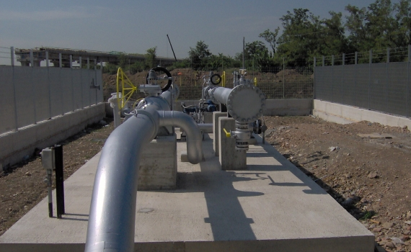
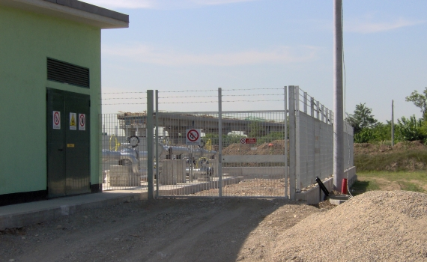
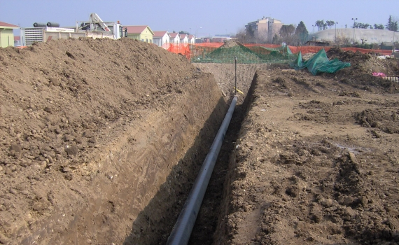
CONSTRUCTION OF PIPELINE’S INTERCONNECTION HUB
CLIENT
WHERE
WHEN
DESCRIPTION
Eni S.p.A.
Pero, Rho (MI) - Italy
2006-2007
Construction of a new interconnection hub at Rho for the pipeline Pero-Rho DN 8"/12".

Slide 12
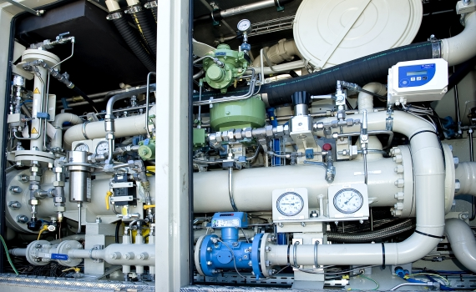
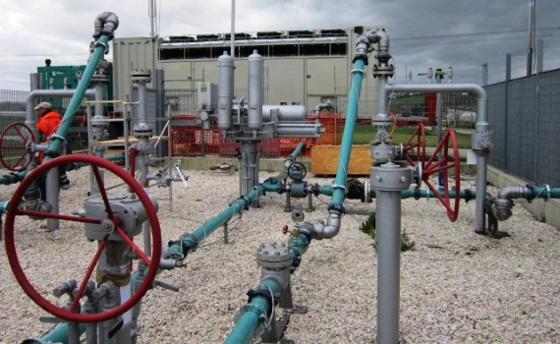
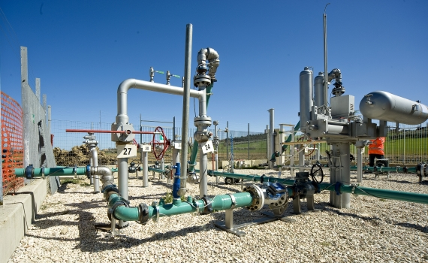
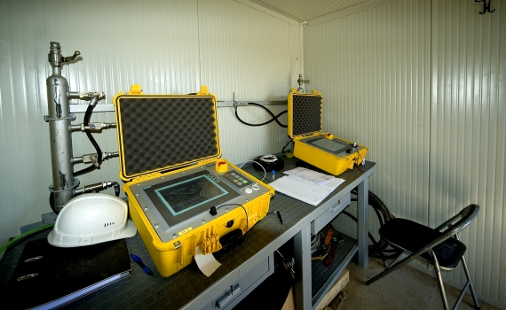
PIPELINE GAS EVACUATION
CLIENT
WHERE
WHEN
DESCRIPTION
GRTgaz
France
2014-2015
Gas evacuation as a result of maintenance work on the gas pipeline.

Slide 13
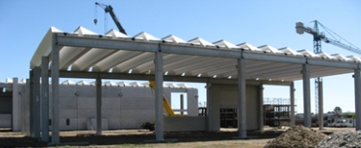
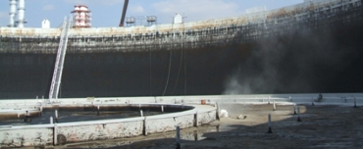
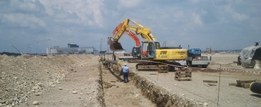
OTHER PROJECTS
NEW OFFICE
C.I.I. GUATELLI S.P.A.
FLOATING ROOF
TK1 REPAIR
HRS
PHASE 5
The project involves the construction of an industrial structure and an independent office building. The industrial structure is composed of three distinct buildings separated by free areas covered by roofing, each of them having the following intended use:
Shed A: workshop assembly
Shed B: warehouse and storage equipment
Shed C: depot of work vehicles
Client: S.A.R.P.O.M. S.r.l.
Repair of the floating roof TK1 of Central Edipower's Turbigo. Blasting sheet metal roof floating in the damaged area and repair with filler metal.
When: 2007
Client: Disma S.r.l.
Work carried out on behalf of Disma S.r.l. at the airport of Malpensa. Mechanical work to the realization of the Phase 5 expansion of the hydrant network for the distribution of fuel to Malpensa Airport.
When: 2006-2007

Slide 14









OUR MAIN CUSTOMERS
ENI S.P.A.
ESSO ITALIANA S.R.L.
S.A.R.P.O.M. S.R.L.
KUWAIT PETROLEUM ITALIA S.P.A.
TAMOIL RAFFINAZIONE
SNAM RETE GAS S.P.A.
TRANS AUSTRIA GASLEITUNG GMBH
GTRGAZ
TERÉGA

Slide 15

QUALITY - ENVIRONMENT - SAFETY
QUALITY CERTIFICATION - ISO 9001
ENVIRONMENT CERTIFICATION - ISO 14001
SAFETY CERTIFICATION – ISO 45001
The ISO 9001 is designed to help organizations ensure that they meet the needs of customers and other stakeholders while meeting statutory and regulatory requirements related to a product. ISO 9000 deals with the fundamentals of quality management systems, including the eight management principles upon which the family of standards is based. ISO 9001 deals with the requirements that organizations wishing to meet the standard must fulfill.
ISO 14001 is related to environmental management that exists to help organizations to minimize how their operations (processes, etc.) negatively affect the environment (i.e., cause adverse changes to air, water, or land), to comply with applicable laws, regulations, and other environmentally oriented requirements, and to continually improve in the above.
ISO 45001 is an internationally applied standard for occupational health and safety management systems. It exists to help all kinds of organizations put in place demonstrably sound occupational health and safety performance. It is a widely recognized and popular occupational health and safety management system.

Slide 16
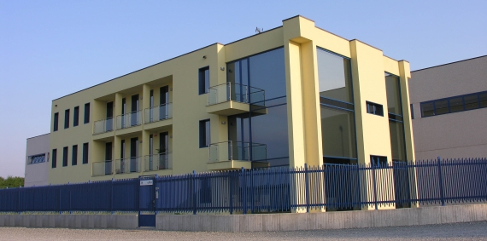
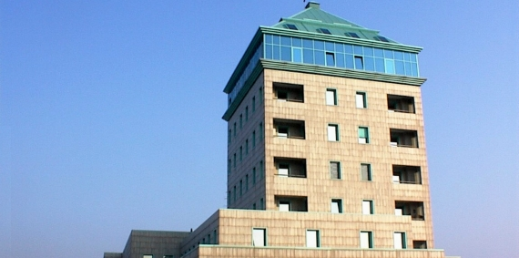
OUR OFFICES
REGISTERED OFFICE
Via Novara 166, 28069 Trecate (NO), Italy
ADMINISTRATIVE HEADQUARTERS
Via Galileo Ferraris 13, 43036 Fidenza (PR), Italy
CAR
TRAIN
AIRPLANE
A4: highway Milano-Torino, exit Novara Est
A26: highway Gravellona Toce-Alessandria, exit Vercelli Est
Train station of Trecate, Novara or Magenta (railway Milano-Torino)
Airport of Milan Malpensa (at about 30 Km)

Slide 17
REGISTERED OFFICE: VIA NOVARA 166, 28069 TRECATE (NO) – PHONE: +39.0321/784111 – FAX: +39.0321/784150
ADMIN. HEADQUARTERS: VIA G. FERRARIS 13, 43036 FIDENZA (PR) – PHONE: +39.0524/530259 – FAX: +39.0524/530142
v1.8 - 20220920
Certified company ISO 9001:2015 – ISO 14001:2015 – ISO 45001:2015
Certificates N° ER-0274/2006 – GA-2012/0248 – SST-0064/2019
info@ciiguatellispa.it
www.ciiguatellispa.it

